Slide 1
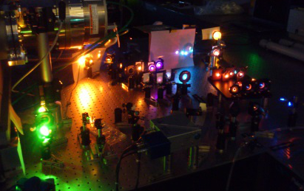

FemtoUP 2021
PyMoDAQ-Femto Installation
Sébastien Weber
18 mars 2021

Slide 2

Setting up a python environment
py35env
On your computer :
v : 3.5
Environment related to python 3.5
For a specific use
py27env
v : 2.7
py38env
Environment related to python 2.7 old packages
v : 3.9
Environment related to python 3.9
For latest features testing
Various python installed :
Some are system wide
Located within programs (e.g. InkScape…)
Some versions required for specific programs (v2.7 for old ones, 32bits version, specific packages not compatible...)
Solution : using an environment manager

Slide 3
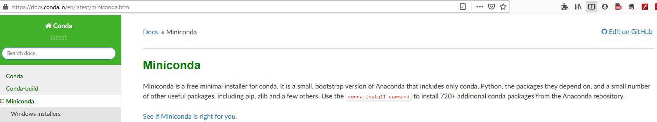
Using conda as environment manager
py38env
Managing environment (conda or venv):
One python version
Given packages
v : 3.9
Environment related to python 3.9
For latest features testing
Package1
Package2
…
Managing packages (conda or pip):
Specific packages on given servers
Conda server using conda
PyPi server using pip
Lightweight conda : Miniconda

Slide 4
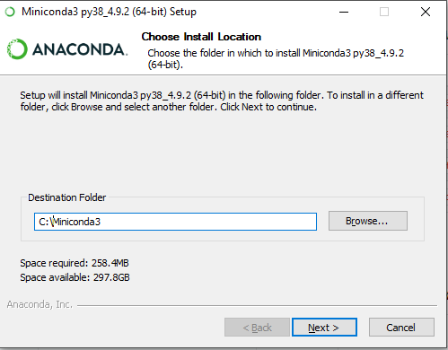
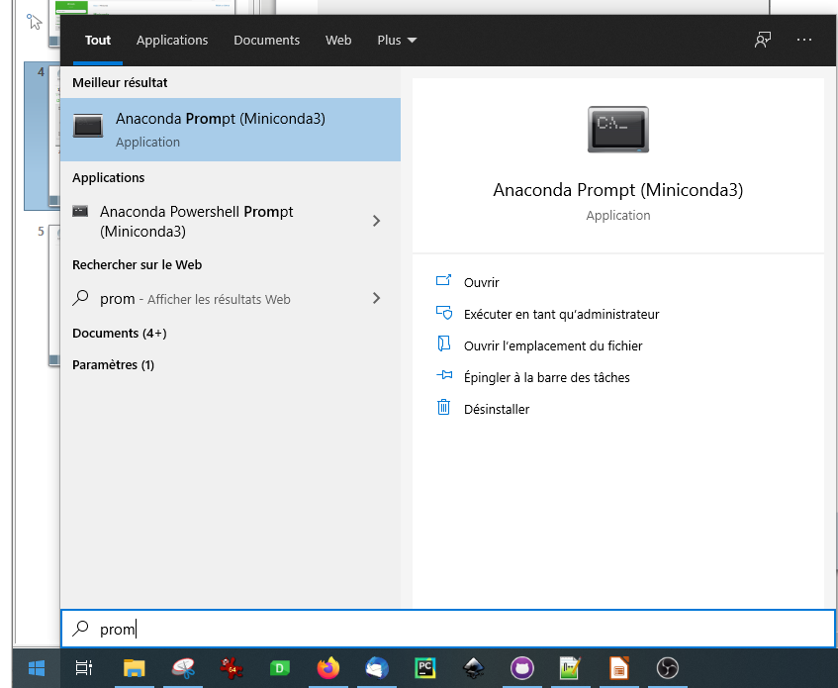
Installation using Miniconda
1) Installing Miniconda (on root folder for ease)
2) Starting the Command Prompt

Slide 5
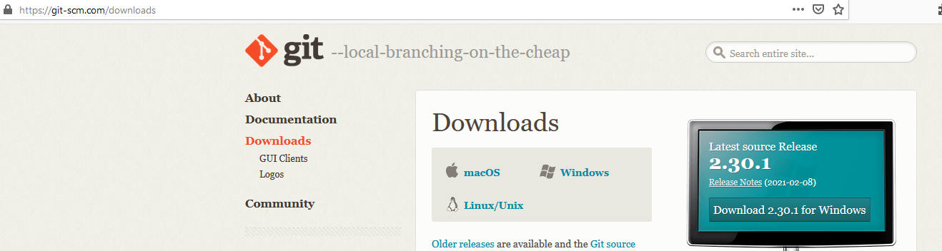
Other required software: Git
Required to get last development packages for the practicals
(Mac and Linux users may already have it on their computer!)
To check this enter « git --version » on your command line

Slide 6

Creating and using environment
In the anaconda prompt
Create a new environment
Activate it
Install packages
One should install :
Spyder (using conda)
Jupyterlab (using pip)
Pymodaq (using pip)

Slide 7
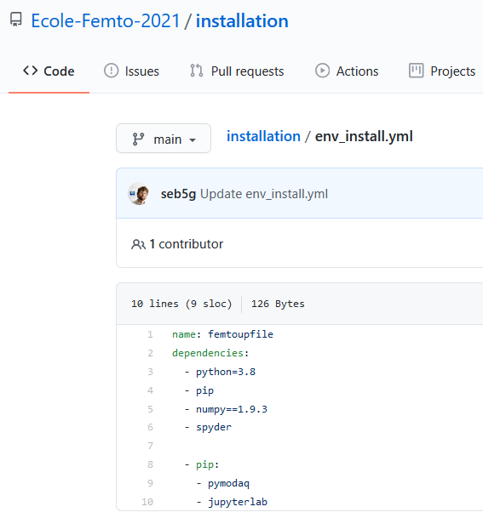
Environment file
https://github.com/Ecole-Femto-2021/installation/
Environment name
Packages installed using conda server : « conda install mypackage »
Packages installed using pip server : «pip install mypackage »

Slide 8
Updating the Environment
If for some reason, the environment file is modified, you’ll need to download it again and update the environment using :

Slide 9
Now is your turn!

